Slide 1
Feature selection performance of Grace-AKO and BIPnet, recent methods that leverage prior grouping information
Aidan Neher - Dec. 12, 2023

Slide 2
Why compare GRACE-AKO and BIPnet?
 | GRACE-AKO (Tian et al. 2022) | BIPnet (Chekouo & Safo 2021)
Recently Proposed | ✅ | ✅
Incorporates prior grouping information | ✅ | ✅
Performs feature selection in high-dimensional settings | ✅ | ✅
Has finite-sample FDR control | ✅
Integrates multiple data types/ “views” |  | ✅

Slide 3
GRACE-AKO: A method where FDR is of concern
Goal | Perform feature selection in high-dimensional settings while controlling the finite-sample FDR and improving model stability.
Strategy | Ensemble learning: Replicate model-X knockoff procedure multiple times and aggregate results.
Application | -Omics data with grouping structure e.g. transcription factors and their regulated genes/ gene products.
Pros | Finite-sample FDR control
Cons | Poor power

Slide 4
Bayesian integrative analysis and prediction with application to atherosclerosis cardiovascular disease (Thierry Chekouo, and Sandra Safo 2023)
BIPnet combines Factor Analysis + Bayesian framework for joint association and prediction.
Why?
Factor analysis reduces observed features into fewer latent factors.
Bayesian approach allows prior grouping information.

Slide 5
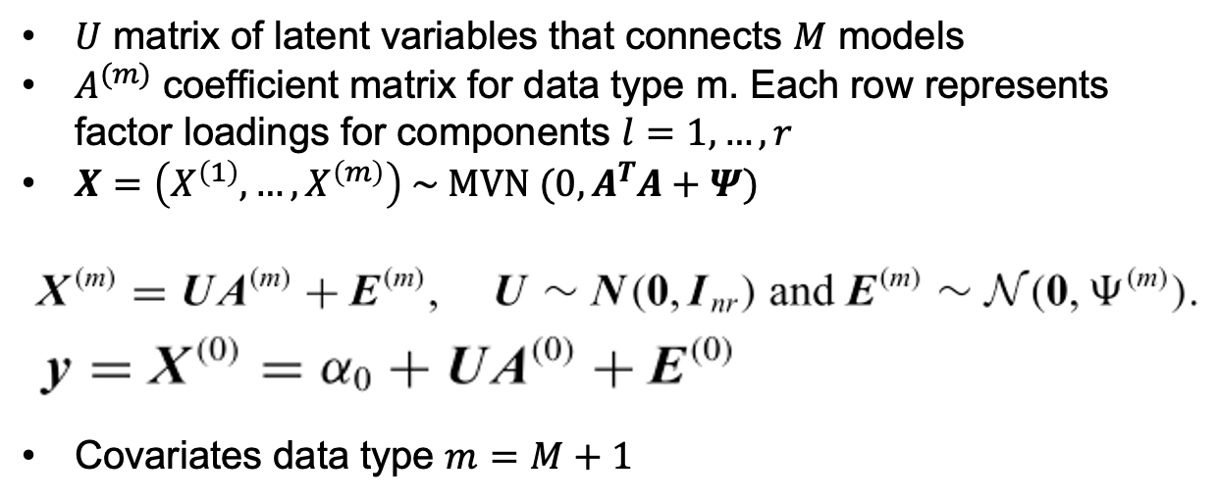
Model: Factor analysis relates multiple -omics data

Slide 6
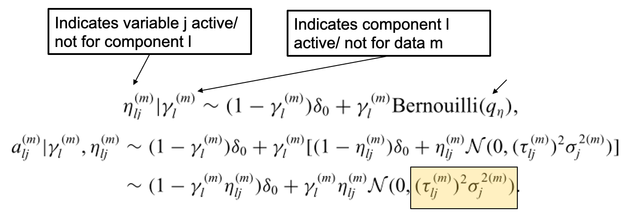
Binary indicators are used for component & feature selection:

Slide 7
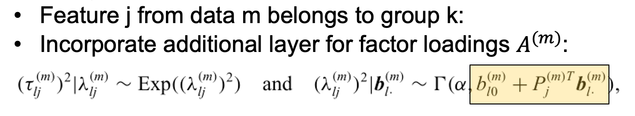
Binary indicators used to distinguish group membership:

Slide 8
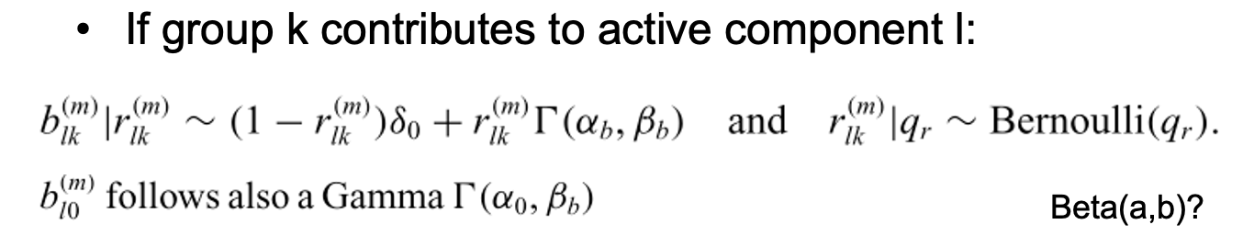
Groups contribute to active latent factor/ not:

Slide 9
Data Simulation: Complicated to harmonize across methods
1 | 0.4
0.4 | 1 | 0.16
0.4 | 0.16 | 1 | …
0.4 | 0.16 | 0.16 | 1 | …
0.4 | 0.16 | 0.16 | 0.16 | 1 | …
0.4 | 0.16 | 0.16 | 0.16 | 0.16 | 1 | …
0.4 | 0.16 | 0.16 | 0.16 | 0.16 | 0.16 | 1 | …
0.4 | 0.16 | 0.16 | 0.16 | 0.16 | 0.16 | 0.16 | 1 | …
0.4 | 0.16 | 0.16 | 0.16 | 0.16 | 0.16 | 0.16 | 0.16 | 1 | …
0.4 | 0.16 | 0.16 | 0.16 | 0.16 | 0.16 | 0.16 | 0.16 | 0.16 | 1
10 groups of 1 primary feature and 9 secondary features i.i.d. MVN with mean 0 and covariance ->

Slide 10
Data Simulation: Complicated to harmonize across methods
For n=100 observations x p=500 features:
Simulate 10 i.i.d. MVN groups of 10 features.
Put 5 groups (50 features) in each of 2 ”views” (X1 and X2).
Generate p/2 – 50 singletons i.i.d. N(0,1) to make dim(X1)=dim(X2)=(n, p/2)
Define 2 groups as important in each view:
beta1=(5, 5/sqrt(10), …, -3, -3/sqrt(10), …, 0, …, 0)
beta2=(-5, 5/sqrt(10), …, 3, 3/sqrt(10), …, 0, …, 0)
Y = (X1, X2) %*% (beta1,beta2) + epsilon, where epsilon i.i.d N(0,1)

Slide 11
Preliminary Results (n=100, p=500)
 | FDR | TPP | N Features Selected
GRACE | 0.0 | 0.05 | 2
GRACE-AKO | 0.0 | 0.05 | 2
BIPnet | 0.5 | 0.20 | 16

Slide 12
Unexpected Challenges: Challenging computationally & in terms of consistency
Defining a plausible covariance matrix for the data simulation that can relate to both methods.
Similarly, specifying the grouping design matrices appropriate to each method took some time. Note, GRACE-AKO W’s were fixed to 1, which might be an advantage of the method to explore.
Degrees of freedom in simulation studies made it difficult to make clear decisions about how to structure data and analyses e.g. the MPP threshold for Marginal Posterior Probability Global of Variable Selection.
Notes:
My correlation structures/ effect sizes might be too weak/ strong, so I want to vary in simulations going forward.
Furthermore, I want to estimate variability. This will require development of bootstrap, which will be challenging due to the computational intensiveness of both methods.
Also, it would be great to include the base BIP, which does not include grouping information as well as a more tried and tested method, which I might use to ensure my simulated data is reasonable.

Slide 13
My (many) questions
Data Simulation:
How might I choose the in-group correlation magnitudes?
How might I vary group heterogeneity within a view and across views X1 and X2?
How might I vary the separation of groups important to Y across X1 and X2?
Analysis: What’s a tried-and-true method I might compare BIPnet & GRACE-AKO to?
Generally: How should I make simulation decisions/ How do I know my simulation’s a “good” one?
Notes:
I’m particularly interested in what you might think as an interesting question to explore further, especially in relation to the data I’m using to assess the methods in and additional method(s) I might compare to.

Slide 14
Degrees of Freedom ”Puzzle Map”
 | GRACE-AKO | BIPnet
n, p, p1, p2 | n=100, p=500, p1=p2=250 | n=100, p=500, p1=p2=250
Intra-group primary, secondary correlation | 0.4, 0.4^2 | 0.4, 0.4^2
Probability a group is indeed a group | W_{ij}=1 for all i,j | 1
Inter-view correlation | ? | ?
N groups/ view | 5 | 5
N important groups/ view | 2 | 2
Outcome effect size | Fixed with max=5, min=-5 | Fixed with max=5, min=-5
Method hyperparameters | Selected by CV | r=4
Baseline method | GRACE | BIP (not yet implemented)
Additional method(s) | ? | ?

Slide 15
Conclusions/ comments
Both methods are promising for feature selection. It’s nice that GRACE-AKO has FDR control and that BIPnet performs integration of multiple data types and prediction simultaneously.
There might have been more similar methods to compare. Yet, comparing 2 very different methods gave insight into their nuances.
Notes:
I’m particularly interested in what you might think as an interesting question to explore further, especially in relation to the data I’m using to assess the methods in and additional method(s) I might compare to.

Slide 16


Thank you! Any additional questions?
Tian, P., Hu, Y., Liu, Z. & Zhang, Y. D. Grace-AKO: a novel and stable knockoff filter for variable selection incorporating gene network structures. BMC Bioinformatics 23, 1–16 (2022).
Chekouo, T. & Safo, S. E. Bayesian integrative analysis and prediction with application to atherosclerosis cardiovascular disease. Biostatistics 24, 124–139 (2021).
GRACE-AKO ->
<- BIPnet

